Slide 1

Neighborhood WatchDog
COS 301 Capstone — Demo 2
Jared Williams • Ange Yehouessi • Obed Mbaya • Joshua Mahabeer • Zaman Bassa

Slide 2

Project Overview
Problem
SA communities: rising crime; CCTV is passive & slow
Solution
Centralised platform with real-time AI detection
Core
Zone-based monitoring + instant multi-channel alerts
Tech Stack
YOLOv8 · DeepSORT · FastAPI · Next.js

Slide 3

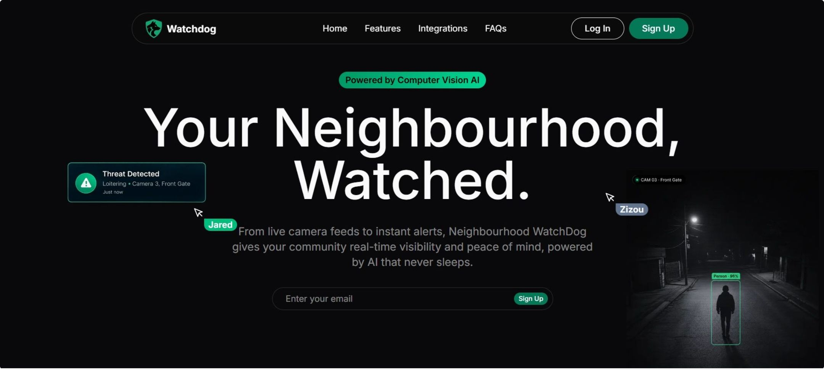
Live Demo: Landing Page & Help Menu
Clean Landing Experience
Polished entry point — fast, focused, intuitive
Quick Navigation
Direct access to all core features
In-App Help Menu
Guided onboarding — no friction

Slide 4



Core Feature 1: Creating a Neighbourhood
Base Unit
Configure
Invite Members
User creates neighbourhood as the foundational unit
Set name, location & member roles
Users can join using a join code

Slide 5

Core Feature 2: Edge Agent Setup & Pairing
01
Connect Device
Attach physical camera or edge hardware
02
Secure Pairing
Authenticated handshake with platform
03
Frame Ingestion
Real-time video stream begins immediately

Slide 6
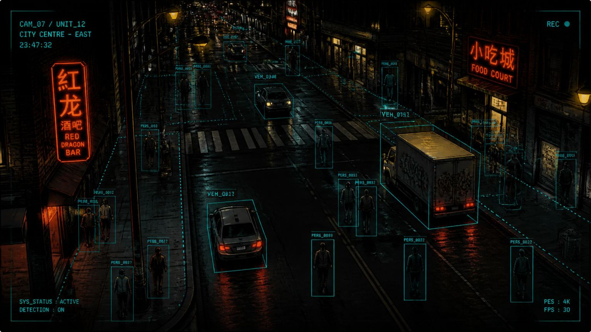

Core Feature 3: Zone (Frame) Configuration
What It Does
Define monitored zones within camera feed
Target detection to specific risk areas
Reduce false positives, sharpen focus

Slide 7
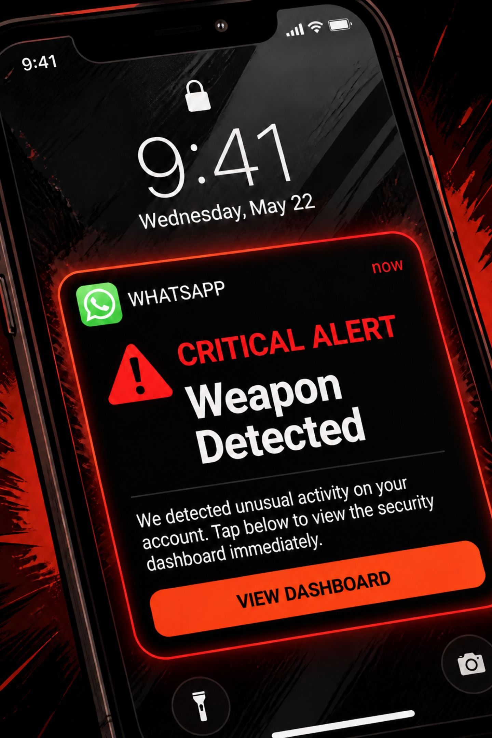



Core Feature 4: Receiving Incoming Alerts
Real-Time Trigger
Multi-Channel
Detection fires instant alert
WhatsApp + Email notifications
Incident Detail
Full context + timestamp included

Slide 8


Core Feature 5: Retrieving Past Alert Footage
1
Search by Date/Time
Look up specific incident windows
2
View Footage
Associated camera clip retrieved instantly
3
Review History
Full incident log with audit trail

Slide 9

CI/CD & Testing
CI Quality Gate
Lint: ruff (Python), ESLint (frontend)
Testing Layers (Target: 80% Coverage)
Type check: mypy
Unit
Integration
Service logic + Pydantic schemas, mocked DB
FastAPI endpoints, real request/response
Security: pip-audit
Tests: pytest, Jest, Playwright
Frontend
E2E
Coverage: Uploaded to Codecov
React Testing Library + Jest
Playwright — full user journeys
Build: Frontend build check
Gate: Deploy blocked if any check fails

Slide 10

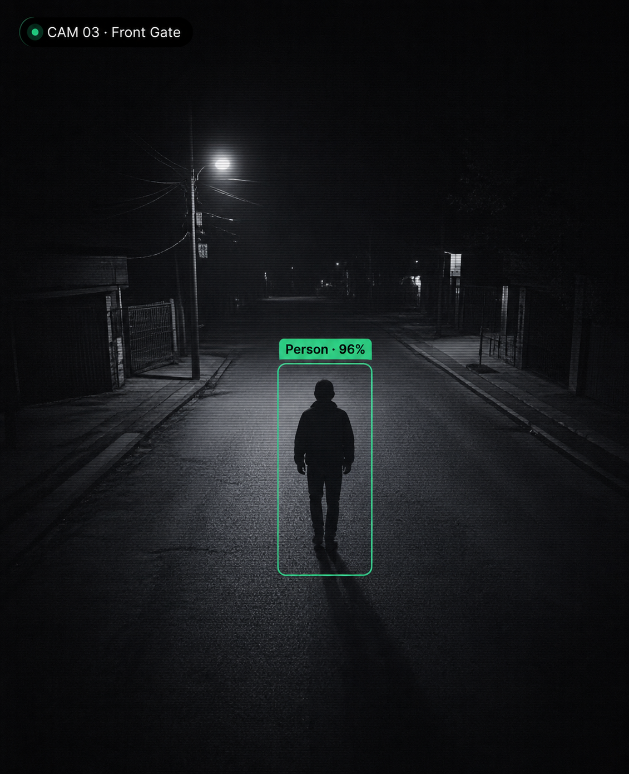
Questions?

